Slide 1
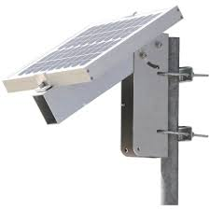

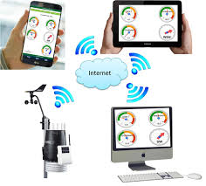
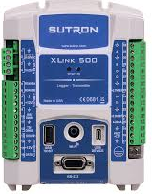
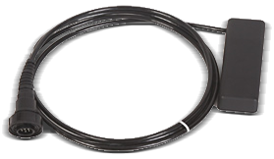
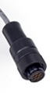
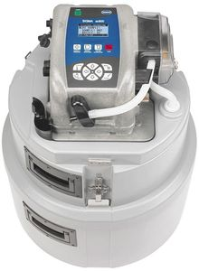
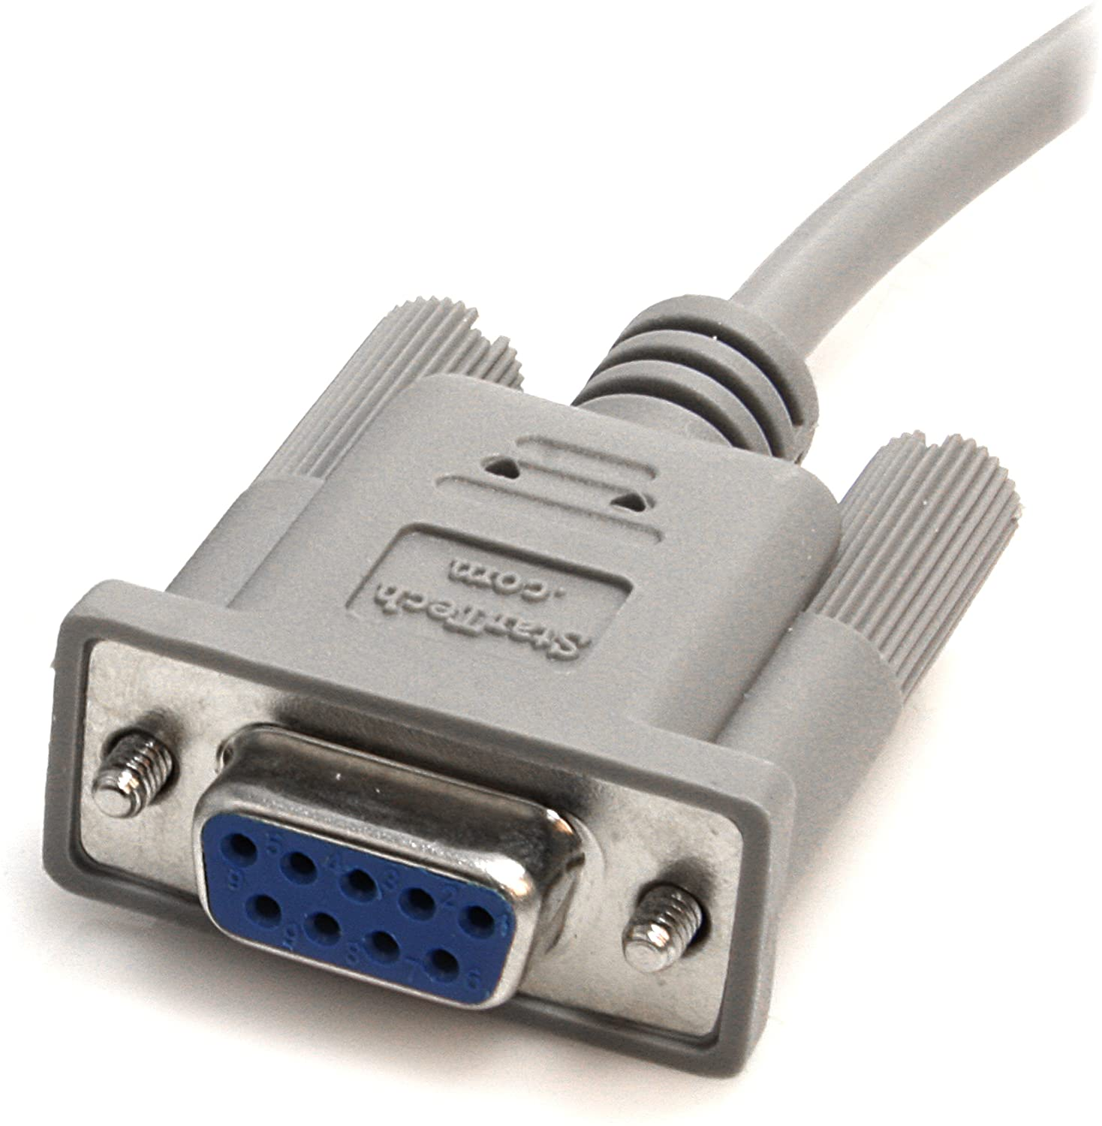
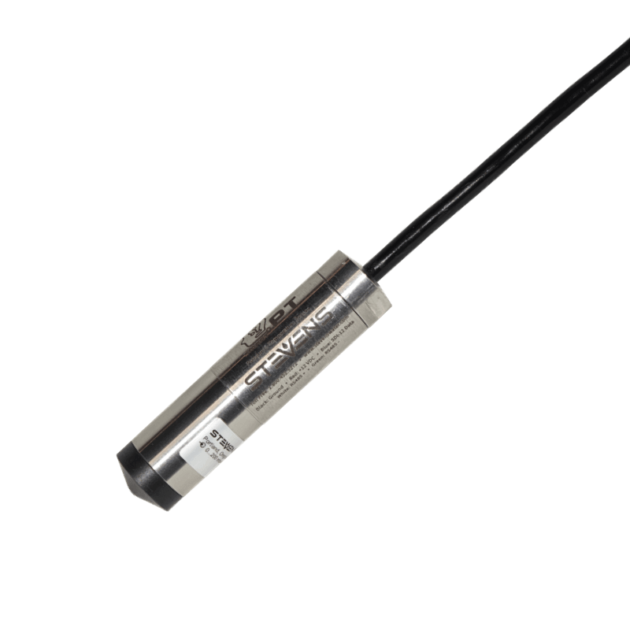
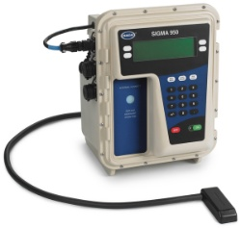
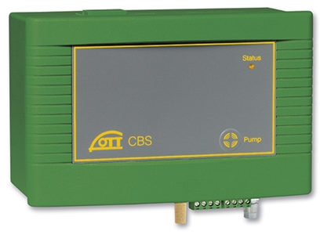
The Sutron Universe
Cell modem to
Phone, PC, server
PSA-AV
sensor
RS-485 MODBUS
Sensor | Level | Velocity | Comm
PSA-AV | ✓ (PT) | ✓ | RS-485
Sigma 950 | ✓ (bubbler) | ✓ | RS-232
Stevens PT | ✓ (PT) | HvF table | SDI-12
OTT | ✓ (bubbler) | HvF table | SDI-12
Switched 12V
Sampler
SDI-12
RS-232
MODBUS
Sigma 950
flowmeter
StevensWater
“SmartPT”
OTT Bubbler

Slide 2
The Sutron Universe
$100
$300
$1,600
Cell modem to
Phone, PC, server
$10-20/month
PSA-AV
sensor
Sensor | Level | Velocity | Price
PSA-AV | ✓ (PT) | ✓ | $2,200
Sigma 950 | ✓ (bubbler) | ✓ | Priceless
Stevens PT | ✓ (PT) | HvF table | $800
OTT | ✓ (bubbler) | HvF table | $2,800
$2,200
Item | Cost
Sutron | $1,600
Flow | $800 – $3k
Sampler | $1k - $3k
Power | $100-400
Telemetry | $120-240/yr
Enclosure | $100-300
Total | $4k – $8k
Sampler
$1,000-3,000
Sigma 950
flowmeter
StevensWater
“SmartPT”
OTT Bubbler
Priceless
$800
$2,800

Slide 3
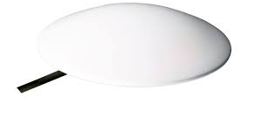
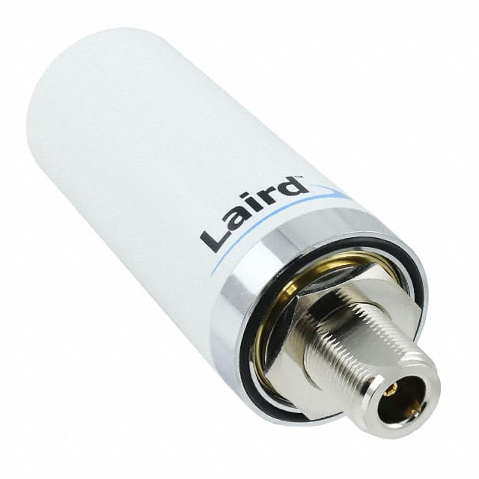
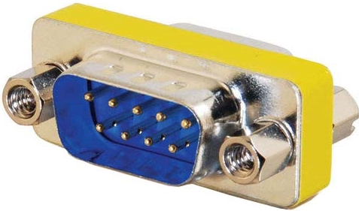
The Sutron Universe
Additional cables and connectors needed
“road dot” antenna
Battery cable
Standard antenna
PSA-AV
sensor
Bulgin 9pin plug
Item | Connection | Price
Battery cable, ring terminals | 2 strand, 16 ga | $25-50
Solar Panel | Bare wires, usually part of solar panel | $0-100
PSA-AV sensor | Bulgin 9 pin female Wire | $30
Sampler | Sampler comm cable (cut to bare wire) | $227 / 2
Sigma 950 | Hach data download Male/male adapter | $95 $3
Antenna | SMA | $50-75
Hach sampler control cable
Flying leads
Sampler
Hach data download cable
w/male male adapter
StevensWater
“SmartPT”
Sigma 950
flowmeter
OTT Bubbler

Slide 4
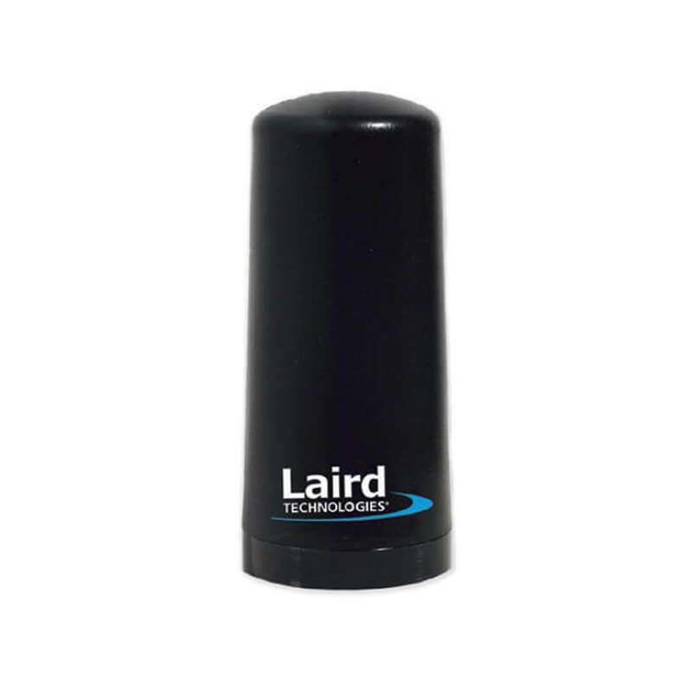
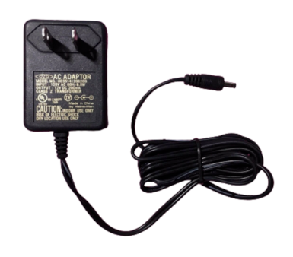
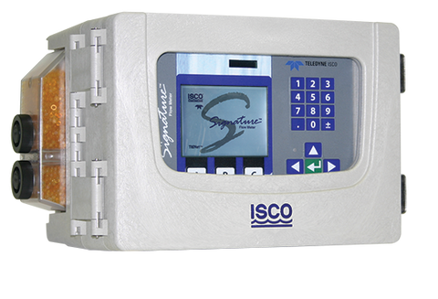
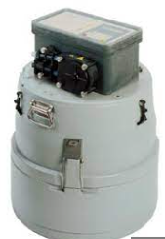
AC to DC power supply
Cellular antenna
ISCO Signature
flowmeter
Cell modem to
Phone, PC, server
RS-485
MODBUS
Sensor | Comm | $$
Signature | RS-485 | NA
3700 Sampler | V pulse | NA
Sutron Xlink |  | $1,600
Cell data plan |  | $150/yr
Antenna w/cable |  | $300
Sampler control cable |  | $250
Enclosure |  | $200
Power Supply |  | $50
Total: |  | $2,400 +cell plan
Hach sampler
control cable
Enclosure
ISCO 3700
Sampler

